Slide 1
Introduction to Machine Learning
CMPUT 328
Nilanjan Ray
Computing Science, University of Alberta, Canada
Material source: “Hands-on machine learning with Scikit-Learn and TensorFlow: concepts, tools, and techniques to build intelligent systems,” by Géron, Aurélien.

Slide 2
What is machine learning?
[Machine Learning is the] field of study that gives computers the ability to learn without being explicitly programmed.
-Arthur Samuel, 1959
A computer program is said to learn from experience E with respect to some task T and some performance measure P, if its performance on T, as measured by P, improves with experience E.
-Tom Mitchell, 1997

Slide 3
Why do we need machine learning?
Consider the spam filter example in your email.

Slide 4
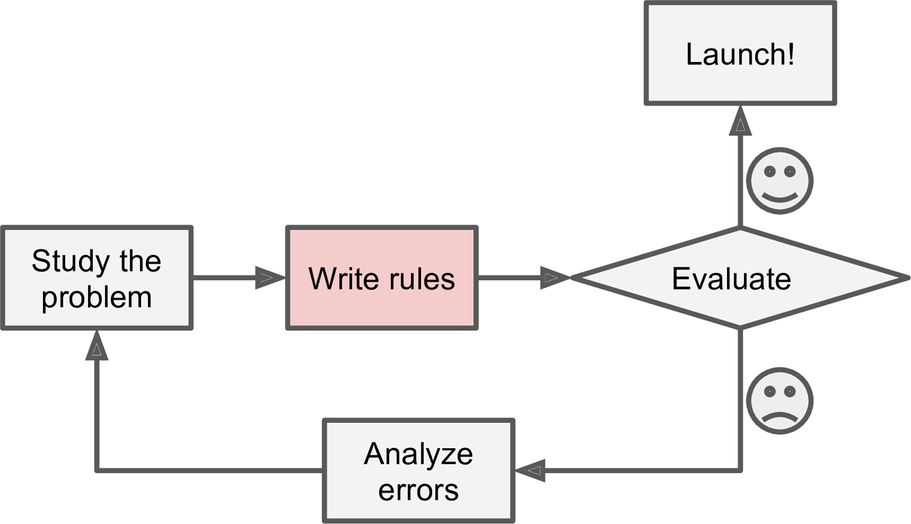
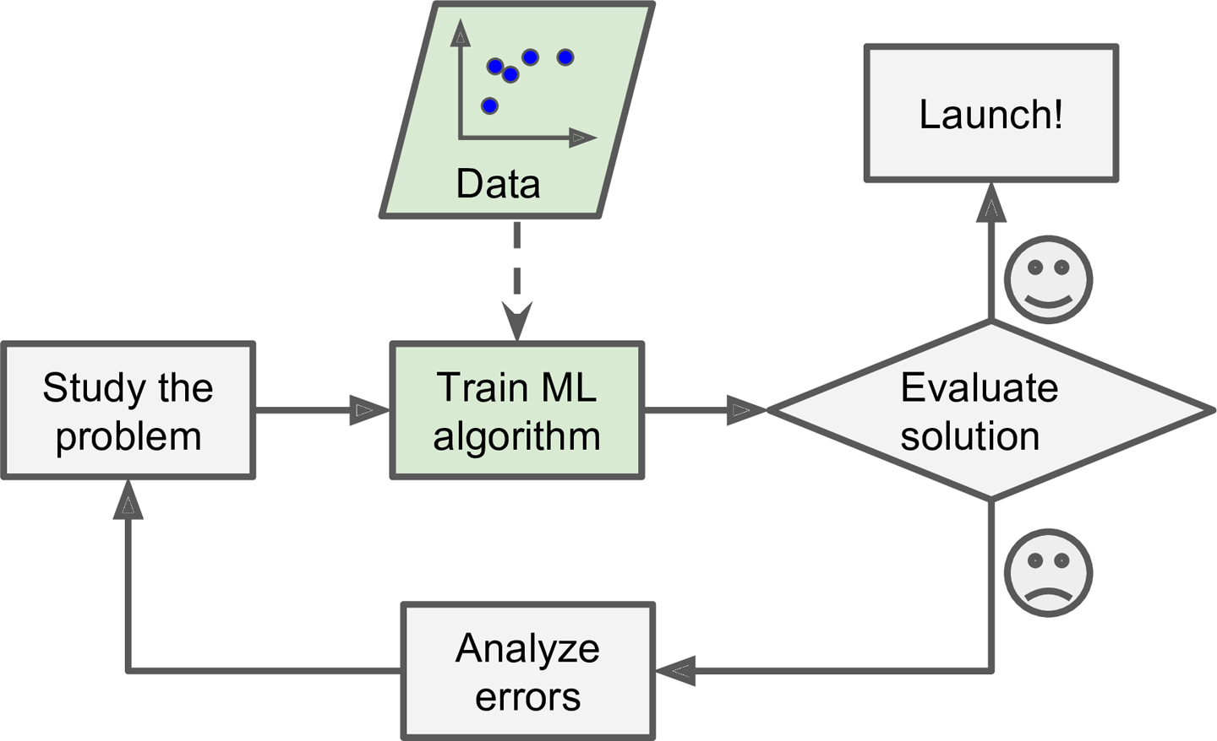
Traditional vs. machine learning approach
Traditional view
ML view

Slide 5
Summary: why we need ML
Problems for which existing solutions require a lot of hand-tuning or long lists of rules: one Machine Learning algorithm can often simplify code and perform better.
Complex problems for which there is no good solution at all using a traditional approach: the best Machine Learning techniques can find a solution.
Fluctuating environments: a Machine Learning system can adapt to new data.
Getting insights about complex problems and large amounts of data.

Slide 6
Types of ML
Whether or not they are trained with human supervision (supervised, unsupervised, semisupervised, and Reinforcement Learning)
Whether or not they can learn incrementally on the fly (online versus batch learning)
Whether they work by simply comparing new data points to known data points, or instead detect patterns in the training data and build a predictive model, much like scientists do (instance-based versus model-based learning)
These criteria are not exclusive; you can combine them in any way you like. For example, a state-of-the-art spam filter may learn on the fly using a deep neural network model trained using examples of spam and ham; this makes it an online, model-based, supervised learning system.

Slide 7
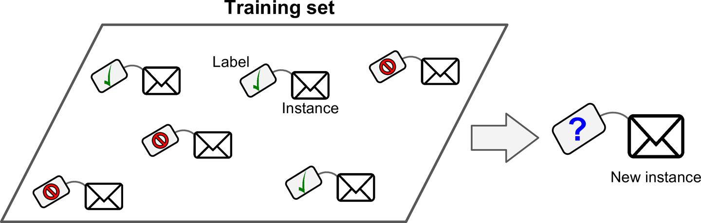
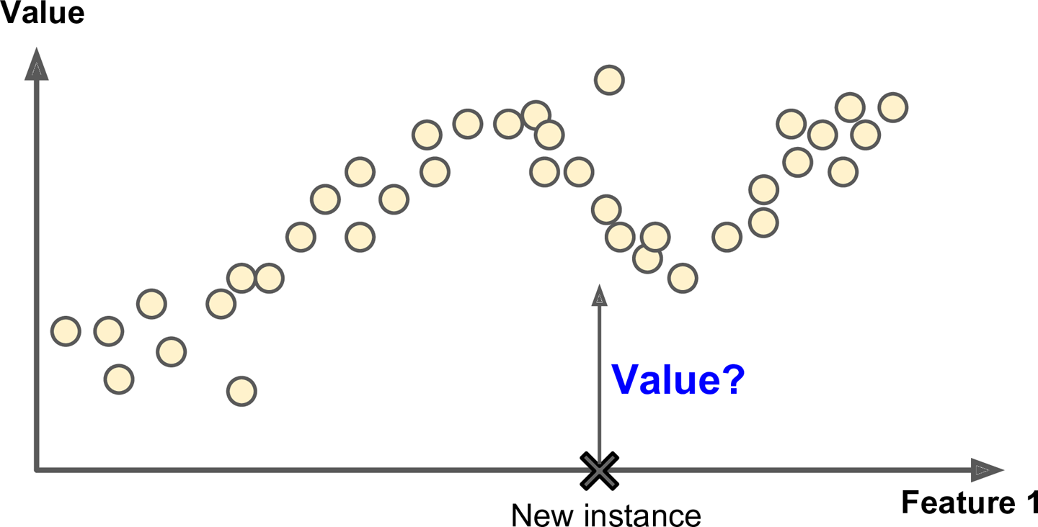
Supervised learning
Classification:
The spam filter is a good example of this: it is trained with many example emails along with their class (spam or ham), and it must learn how to classify new emails.
Regression: Another typical task is to predict a target numeric value, such as the price of a car, given a set of features (mileage, age, brand, etc.) called predictors. To train the system, you need to give it many examples of cars, including both their predictors and their labels (i.e., their prices).

Slide 8
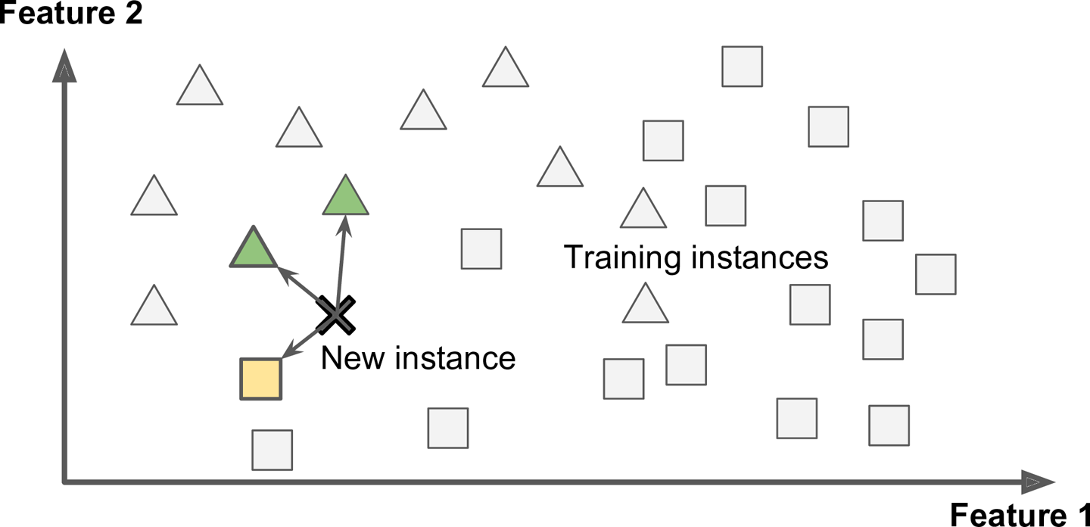
Instance-based supervised learning
Remember all training examples
When a test email comes, compare it with its “neighbors” from the training examples and classify accordingly
Requires a measure of similarity
Example: k-nearest neighbor (knn) method

Slide 9
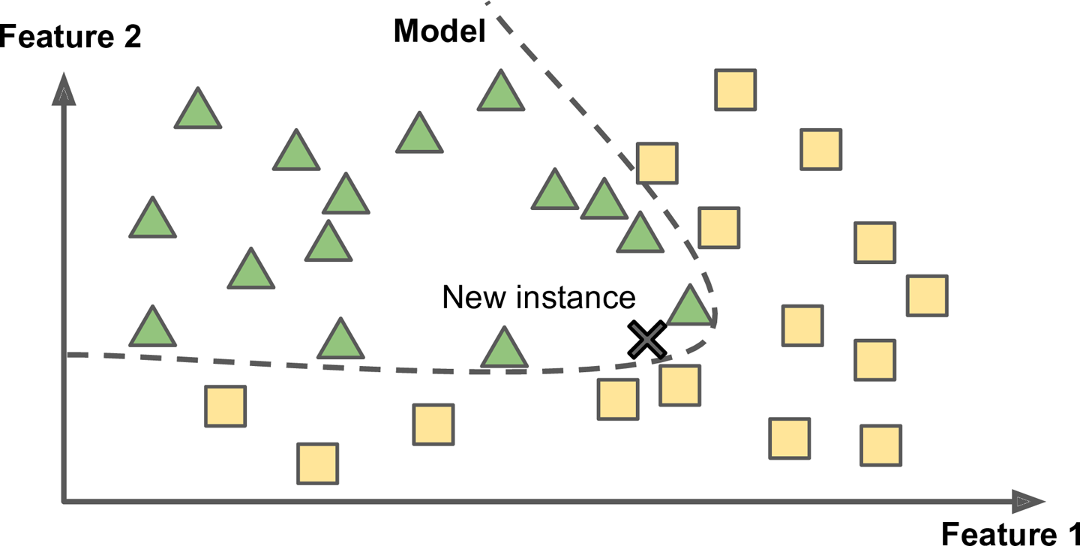
Model-based supervised machine learning
From all the training examples, build a model for the learner
When a test example comes, apply the model
Don’t need to remember all training examples, after training
Examples: neural net, support vector machine, linear regression, etc.

Slide 10
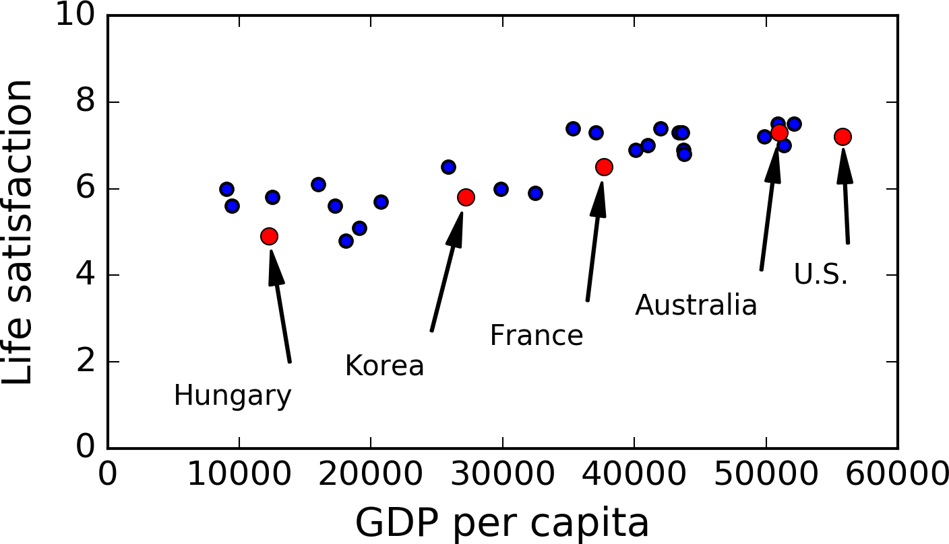
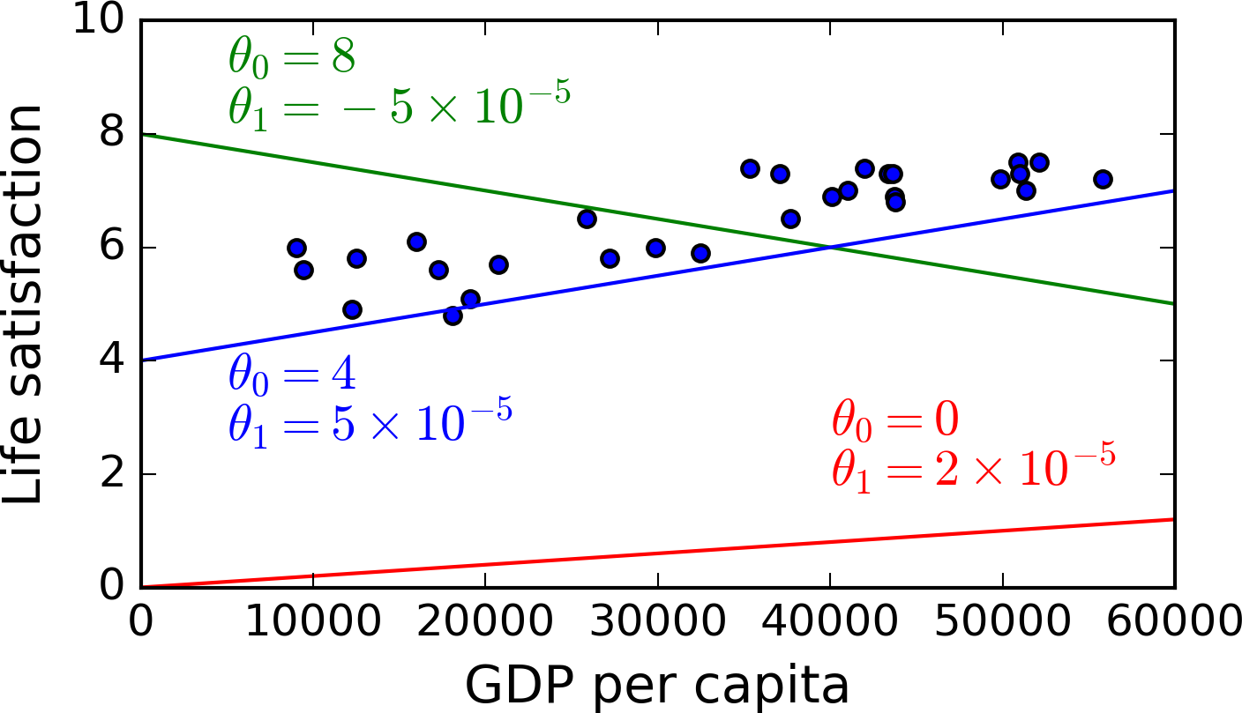
Linear-model based supervised learning
Do we see any trend?
A few possible linear models
Linear model:
Parameters of the model: θ₀, θ₁

Slide 11
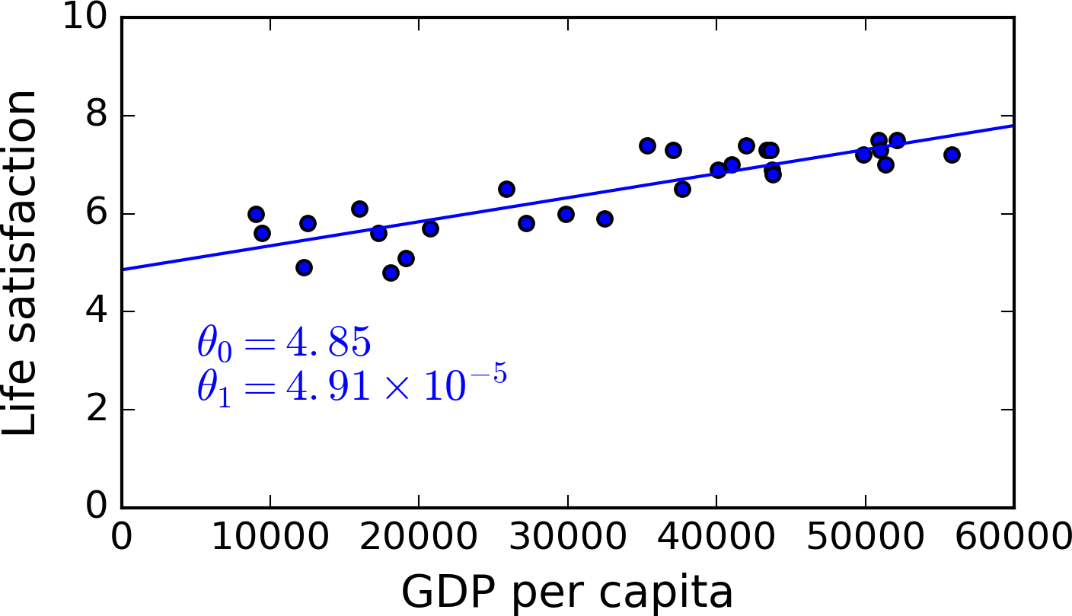
Linear-model based supervised learning
Best fit linear model

Slide 12
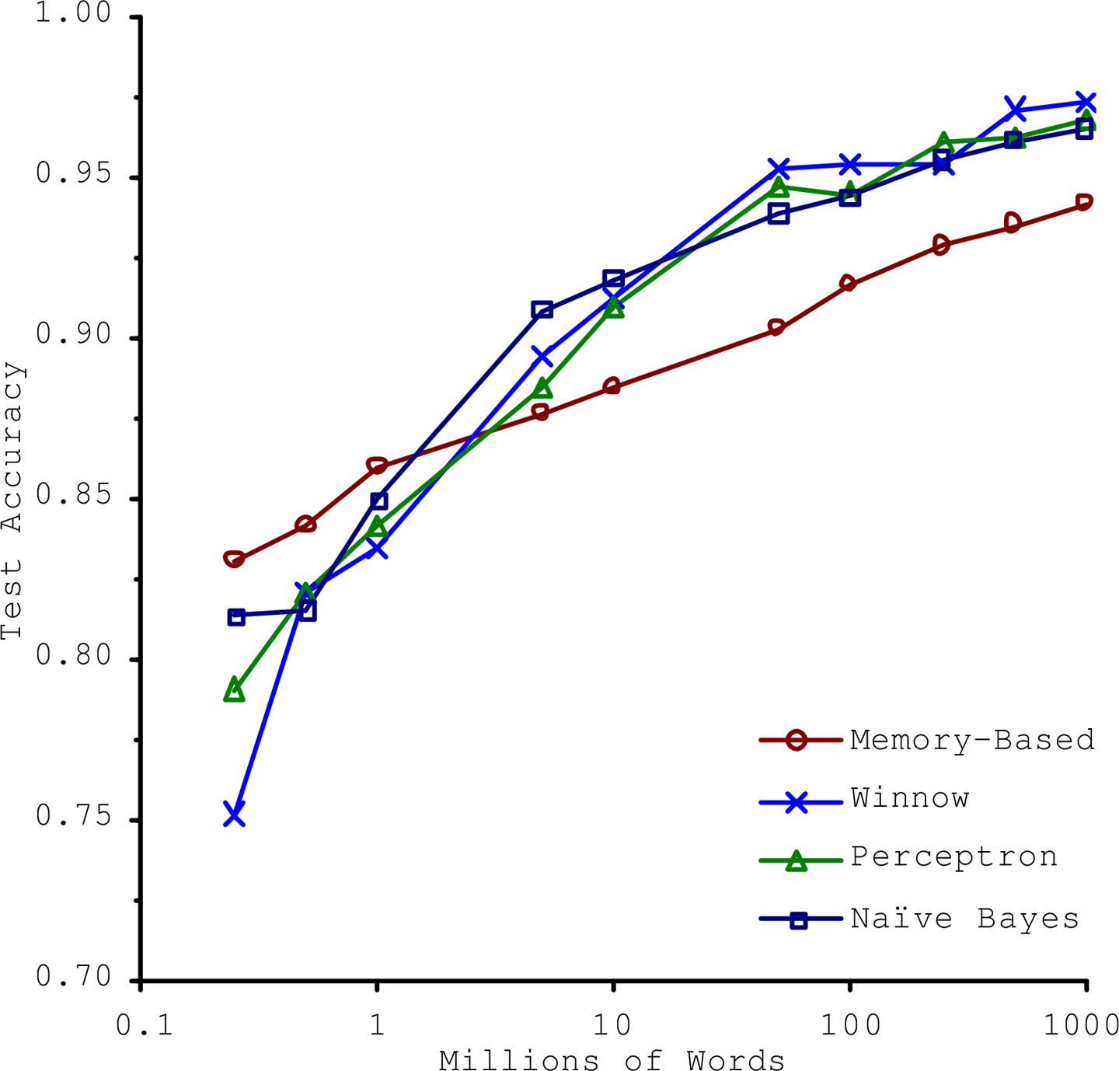
Challenge 1
Insufficiency of labeled training data
The importance of data versus algorithms: by Peter Norvig

Slide 13
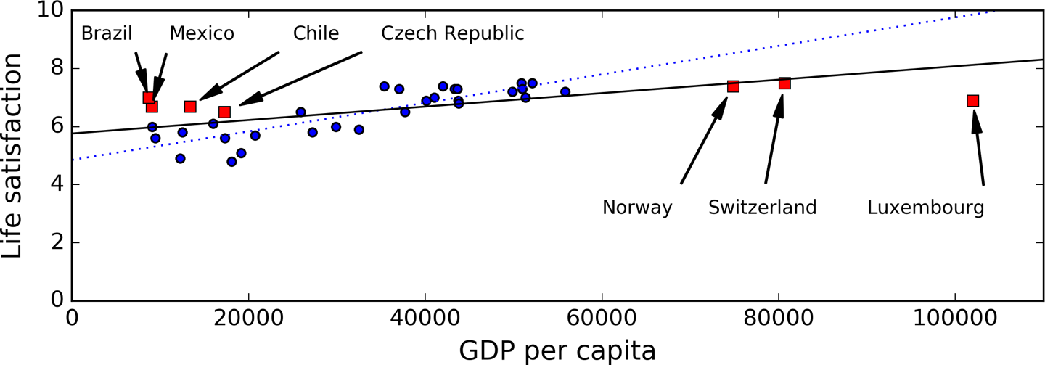
Challenge 2
Non-representative training data

Slide 14
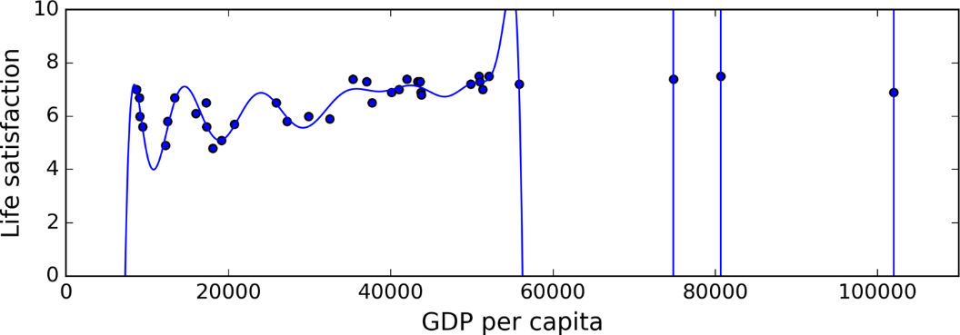
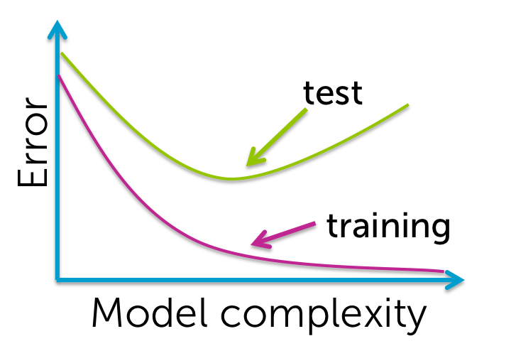
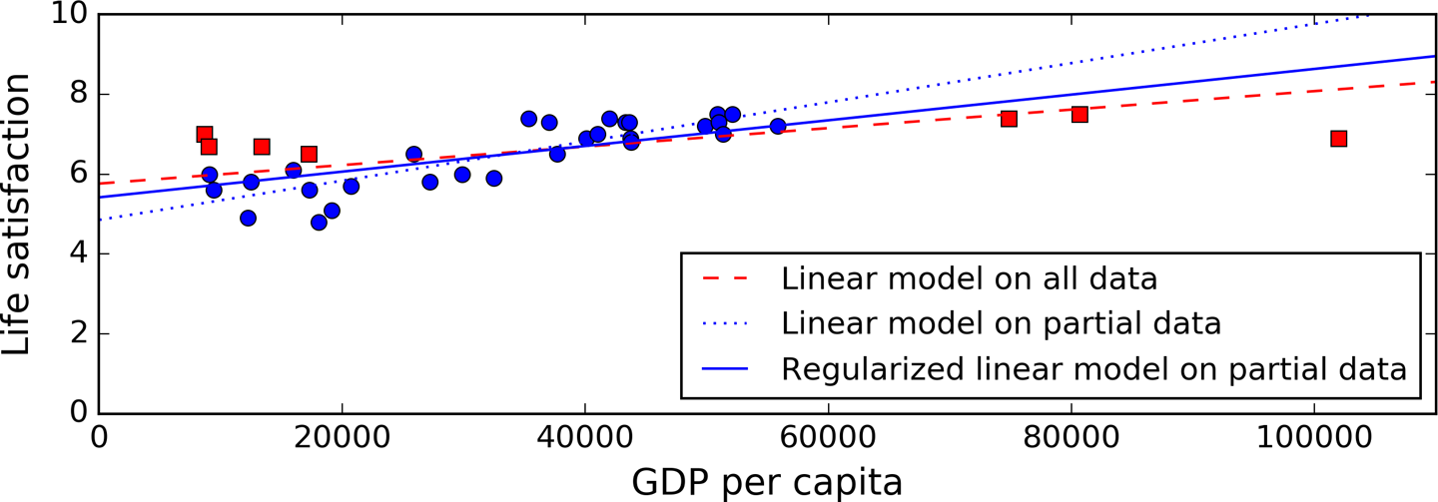
Challenge 3
Right model
Fitting a high degree polynomial: typical overfitting
Under fitting
Over fitting
Regularization reduces risk of overfitting
What is regularization?

Slide 15
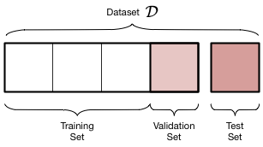
Testing and validating model
No free lunch theorem: David Wolpert demonstrated that if you make absolutely no assumption about the data, then there is no reason to prefer one model over any other.
In practice, you have to try a model to your data to see how well it performs
Divide data into training, validation and test. We will see how to use these in the practical session.

